Slide 1
Personal Pronouns as Features in Polarity Classification of Amazon Reviews
Presented by
Joe Blankenship, Pramiti Barua,
Jaswitha Ravala

Slide 2
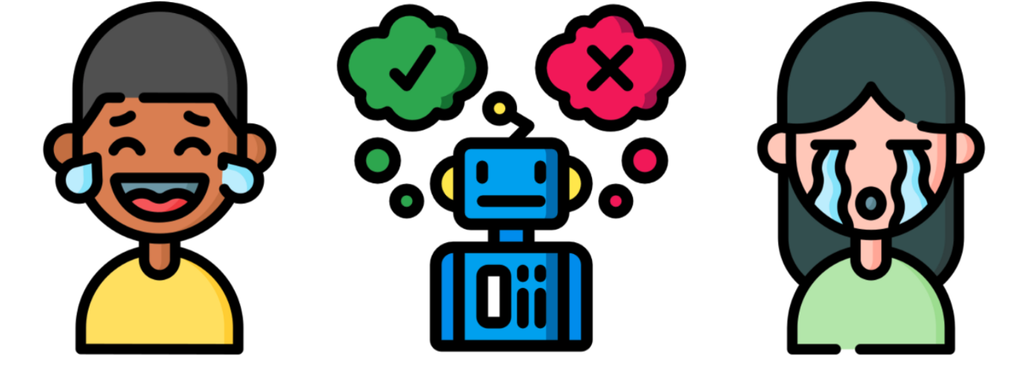
Sentiment analysis
Refers to opinion or attitude of a speaker
Determines opinion in a document or text
Uses natural language processing, text analysis, machine learning

Slide 3
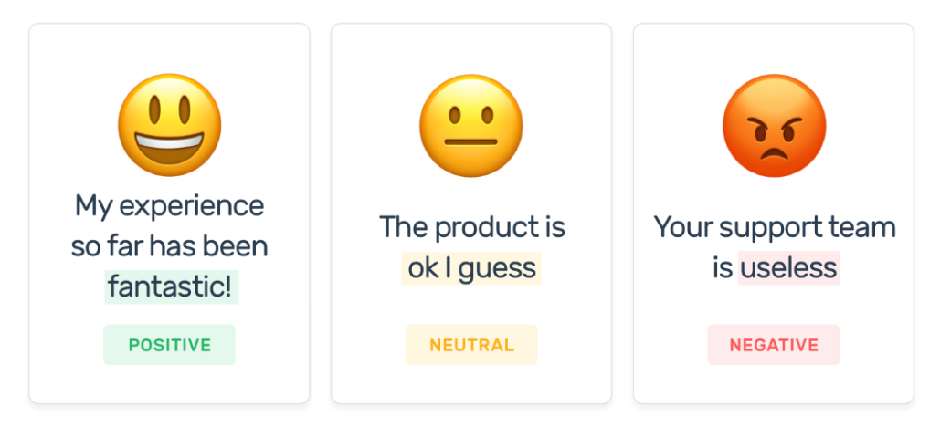
Why Sentiment analysis
Success depends on customers
Company needs to analyze their product performance
Need analyze sentiment of customers
Notes:
Company have million of customers, they need to analysis the sentiment of the cutomers to understand their feedback about a specific product.

Slide 4

Research Question
Are personal pronouns (“I”, “he”, “she”, “me”) useful when classifying reviews into star categories by sentiment?

Slide 5
Steps
Dataset
Preprocessing
Sentiwordnet
Models
Results
Classification

Slide 6
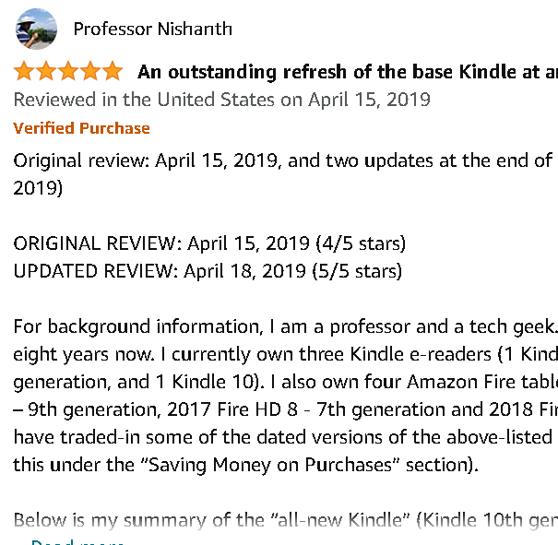
Amazon Review Text and Star Ratings
Label
Document
https://www.amazon.com/Kindle-Now-with-Built-in-Front-Light/dp/B07978J597/ref=sr_1_1?keywords=kindle&qid=1636501189&sr=8-1&th=1

Slide 7

Dataset
5,000 Amazon reviews
Each review has a star rating from one to five
One star: 63
Two star: 54
Three star: 197
Four star: 1208
Five star: 3489

Slide 8
Preprocessing
Create two stop word lists.
Remove stop words from text
Do tokenization (tag each word with part of speech)
Removed punctuation
Replaced capital letters with small letters

Slide 9
Two Examples of Amazon Reviews
Positive Review (Five Star):
"This was easy to use. You will love it!"
Negative Review (One Star)
"Returned after a week. No Good."

Slide 10
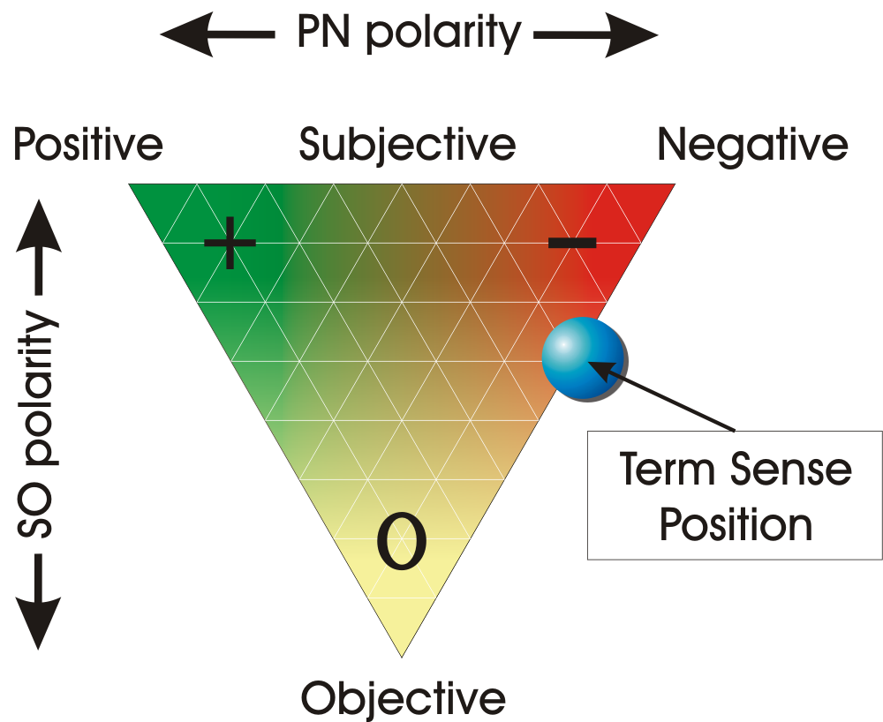
Sentiwordnet 3.0
"week"
Positive Score | 0.1
Negative Score | 0.7
"easy"
Positive Score | 0.8
Negative Score | 0.4

Slide 11
Models
Non-pronoun | Pronoun | Pos-pronoun | Neg-pronoun
Pronouns not included | Pronouns included | Pronoun included | Pronouns included
Sentiword scores | Sentiword scores | Sentiword scores | Sentiword scores

Slide 12
Sentiscore
Non-pronoun model
This | was | easy | use | will | love
Pos: 0.1 Neg: 0.2 | Pos: 0.1 Neg: 0.1 | Pos: 0.4 Neg: 0.1 | Pos: 0.3 Neg: 0.3 | Pos: 0.5 Neg: 0.2 | Pos: 0.9 Neg: 0.1
Pronoun model
This | was | easy | use | you | will | love | it
Pos: 0.1 Neg: 0.2 | Pos: 0.1 Neg: 0.1 | Pos: 0.4 Neg: 0.1 | Pos: 0.3 Neg: 0.3 | Pos: 0.0 Neg: 0.0 | Pos: 0.9 Neg: 0.1 | Pos: 0.9 Neg: 0.1 | Pos: 0.0 Neg: 0.0

Slide 13
General Bag of Words Model
Feature | Review 1 | Review 2 | Review 3 | Review 4
This | 2 | 0 | 2 | 1
was | 1 | 3 | 4 | 2
easy | 1 | 3 | 2 | 5
... | ... | ... | ... | ...
Positive Sentiscore | 0.4 | 0.7 | 0.8 | 0.3
Negative Sentiscore | 0.1 | 0.3 | 0.5 | 0.9

Slide 14
Sum of Sentiscores
This | was | easy | use | will | love
Pos: 0.1 Neg: 0.2 | Pos: 0.1 Neg: 0.1 | Pos: 0.4 Neg: 0.1 | Pos: 0.3 Neg: 0.3 | Pos: 0.5 Neg: 0.2 | Pos: 0.9 Neg: 0.1
TOTAL/LENTH OF REVIEW = POS SENTISCORE, NEG SENTISCORE

Slide 15
Models
Feature | Non-pronoun | Pronoun | Pos-pronoun | Neg-pronoun
Pronoun Term Frequency | X | O | O | O
Pronoun Sentiscore = 0 | X | X | O | O
Pronoun Sentiscore = 0.3 | X | X | O | O
Pronoun Sentiscore = 0.5 | X | X | O | O
Pronoun Sentiscore = 0.7 | X | X | O | O
Pronoun Sentiscore = 0.9 | X | X | O | O

Slide 16
Pos-pronoun
This | was | easy | use | you | will | love | it
Pos: 0.1 Neg: 0.2 | Pos: 0.1 Neg: 0.1 | Pos: 0.4 Neg: 0.1 | Pos: 0.3 Neg: 0.3 | Pos: 0.3 Neg: 0.0 | Pos: 0.9 Neg: 0.1 | Pos: 0.9 Neg: 0.1 | Pos: 0.3 Neg: 0.0
Neg-pronoun
This | was | easy | use | you | will | love | it
Pos: 0.1 Neg: 0.2 | Pos: 0.1 Neg: 0.1 | Pos: 0.4 Neg: 0.1 | Pos: 0.3 Neg: 0.3 | Pos: 0.0 Neg: 0.3 | Pos: 0.9 Neg: 0.1 | Pos: 0.9 Neg: 0.1 | Pos: 0.0 Neg: 0.3

Slide 17
Results:
Pronoun Model vs Non-Pronoun Model
Rating | Pronoun Model |  | Non-Pronoun Model
 | Precision | Recall | Precision | Recall
1 | 1.00 | 0.25 | 1.00 | 0.35
2 | 0.00 | 0.00 | 1.00 | 0.09
3 | 0.60 | 0.06 | 0.57 | 0.10
4 | 0.51 | 0.33 | 0.46 | 0.28
5 | 0.77 | 0.92 | 0.75 | 0.92

Slide 18
Results
Pronoun Model vs Non-Pronoun Model
Model | Accuracy
Pronoun Model | 0.73
Non-Pronoun Model | 0.71

Slide 19
Results
Pos-Pronoun Model vs Neg-Pronoun Model
 | Pos-Pronoun Model |  | Neg-Pronoun Model
Rating | Precision | Recall | Precision | Recall
1 | 1.00 | 0.10 | 1.00 | 0.13
2 | 1.00 | 0.10 | 0.00 | 0.00
3 | 0.71 | 0.08 | 0.20 | 0.02
4 | 0.51 | 0.32 | 0.54 | 0.29
5 | 0.79 | 0.95 | 0.76 | 0.94

Slide 20
Result
Pos-Pronoun Model vs Neg-Pronoun Model
 | Accuracy
Sentiscore for Pronoun | Pos-Pronoun Model | Neg-Pronoun Model
0.3 | 0.75 | 0.73
0.5 | 0.73 | 0.71
0.7 | 0.71 | 0.71
0.9 | 0.71 | 0.70

Slide 21
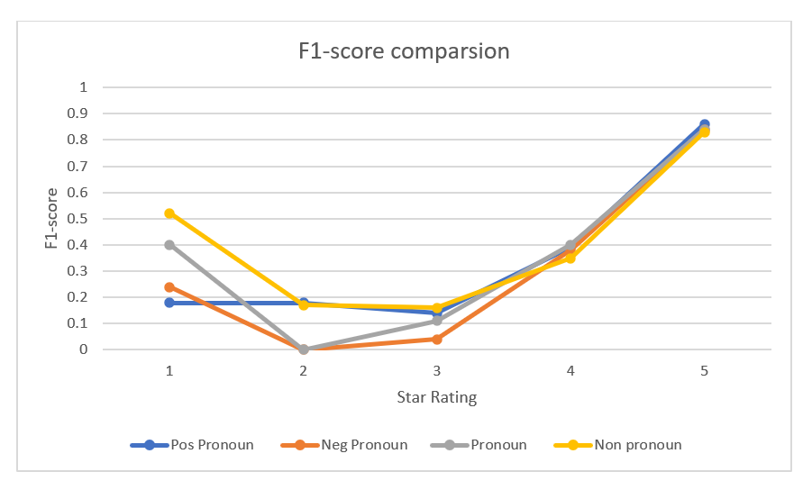
Result Graph

Slide 22
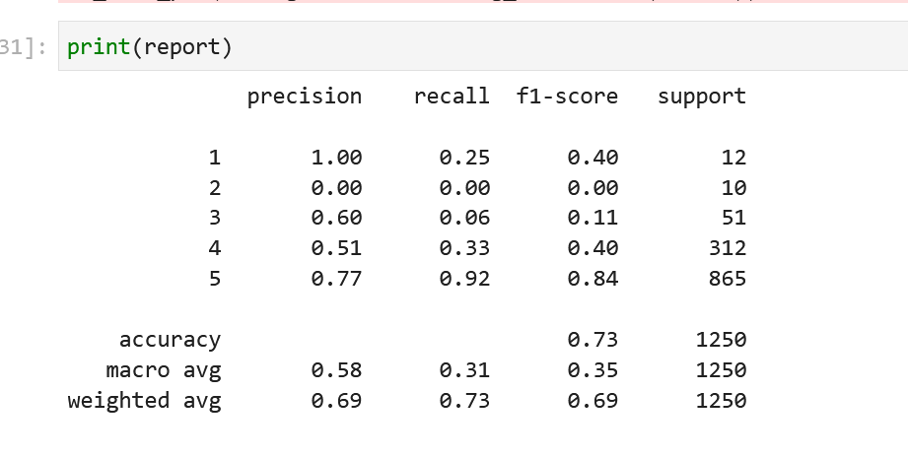
Results of Pronoun Model

Slide 23
Non pronoun Model Top Features
One Star
Neg Sentiscore
Pos Sentiscore
“amazon”
“bought”
“kindle”
“one”
“week”
“use”
“work”
“tablet”
Two Star
Neg Sentiscore
Pos Sentiscore
“use”
“amazon”
“tablet”
“work”
“device”
“bought”
“would”
“apps”
Three Star
Pos Sentiscore
Neg Sentiscore
“tablet”
“good”
“great”
“amazon”
“would”
“kids”
“one”
“apps”

Slide 24
Non pronoun Model Top Features (cont.)
Four Star
Pos Sentiscore
Neg Sentiscore
“tablet”
“great”
“use”
“good”
“like”
“amazon”
“easy”
“kindle”
Five Star
Pos Sentiscore
Neg Sentiscore
“great”
“love”
“tablet”
“use”
“easy”
“bought”
“echo”
“kindle”

Slide 25
Pronoun Model Top Features
One Star
Neg Sentiscore
Pos Sentiscore
“it”
“amazon”
“bought”
“you”
“kindle”
“tablet”
“week”
“they”
Two Star
Neg Sentiscore
Pos Sentiscore
“it”
“you”
“use”
“amazon”
“tablet”
“bought”
“would”
“work”
Three Star
Pos Sentiscore
Neg Sentiscore
“it”
“tablet”
“good”
“you”
“kids”
“great”
“use”
“amazon”

Slide 26
Pronoun Model Top Features (cont.)
Four Star
Pos Sentiscore
Neg Sentiscore
“it”
“you”
“tablet”
“great”
“use”
“good”
“amazon”
“like”
Five Star
Pos Sentiscore
Neg Sentiscore
“it”
“great”
“love”
“tablet”
“use”
“easy”
“you”
“one”

Slide 27
Threats to validity
Relatively small amount of data
Data set is not balanced
One subject of consumer reviews
Bias towards the type of consumers who often buy electronics
Other classifier would have provided better results.

Slide 28
Conclusion
Clear conclusions cannot be drawn from this small dataset
Subject domain plays a big role
Sentiscores are important for classifying by sentiment
Traditional preprocessing may need to be reviewed because more powerful models (neural networks etc) may draw information from pronouns.

Slide 29
Future Work
Study with large data
Study accounting for imbalanced classification problem
Working with Equal Number of star rating data
Use different classifier model

Slide 30


